Slide 1
T A S C S
and
Professor
Peter Turnbull
in cooperation with
Midterm Meeting
29 May 2018, Rotterdam

Slide 2
Agenda
10.30 Introduction to TASCS project (PS)
11.00 Tour de table of all present
11.15 Introduction on practicalities project
11.30 Presentation research
12.30 Lunch
14.00 Presentation research (continued)
15.00 Coffee break
15.30 Discussion
16.30 Summary
17.00 Any other business

Slide 3
TASCS: Objective & motivation
Identification & assessment of (non-) technological developments that impact the work load of crew members during work/rest
AIS, radar, (un)loading schemes, port configuration, stress, type of cargo, water stretch, noise, vibrations, physical equipment, administration, ….
Future proof manning regulation
Notes:
Comment:
More specifically the project must provide a common basis to the Social Partners for their engagement in establishing a European manning framework that meets the needs of the sector.
In order to fully reflect the reality of today’s European IWT sector, the social partners would like to have as much feedback as possible, and thus propose to work in a diversified manner:
Part 1 Compilation & analysis of studies – research – publications – sector information already available;
Part 2 A broad consultation organised amongst operators and crewmembers - consisting of paper/online questionnaires as well as in-the-field interviews.
The project will consist of:
- a preparatory phase,
The preparatory phase includes: the launching of the research part of the project through the researcher/consortium – the preparation of the thematic workshops – the preparation of the final conference – preparation of the documents for the different events.
three thematic workshops,
The main phase will consist of thematic workshops – possible in 3 different countries to get balanced feedback. Topics of the thematic workshops are to be defined at the first Project Steering Committee meeting.
a final conference, and a series of follow-up actions. (publication of a brochure, dissemination of the outcomes, etc.): The final conference will serve to sum up and present the results of the project as well as presenting the brochure.

Slide 4
Goal & Research Questions of TASCS
Evaluating actual time occupancy and work load of crew for inland ships on 7 different categories
Finding relations/correlations for research parameters
Deriving a method/tool for calculating crew manning more sophisticated / better fitting than existing regulations

Slide 5
TASCS - Deliverables
Documented proposal for easy to use manning instrument
flexible, transparent, future proof
with options
and easy to enforce
European interconnected waterways
Spring 2017 - End 2018
Concise report

Slide 6
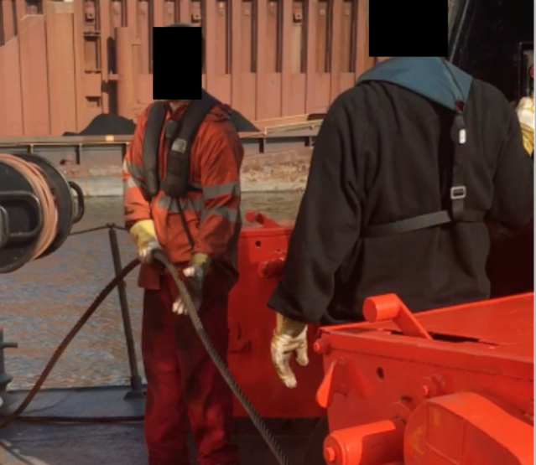
Goal of this TASCS meeting
Presenting current picture of time occupancy and workload
(Interim) Conclusions from the field study and approaches for the tool
Feedback from the steering group

Slide 7
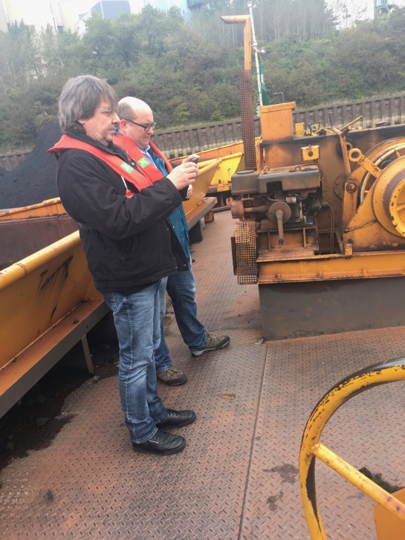
Methodology
Defining parameters to group similar ships
Interview guide for standardization of the interviews based on tasks structure

Slide 8
Observation checklist – ultrashort
Process/ vessel/ load/ organisation/ waterway
Work (to be assessed)
Planning/ preparing
Managing (team, ballast, waste, bunkering, ..)
Sailing/ manoeuvring/ landing/ (un-)mooring/ dredging
(Un-)loading
Periodic inspection, cleaning & maintenance
Administration (customs, logbook, shifts, sailing, ..)
Handling calamities
Other (personal hygiene, cooking, handover, waiting, training, ..)
Recovery (to be assessed)
Shift pattern, when, how much, where, …
Travel/ commuting
Notes:
Items all having impact on workload

Slide 9
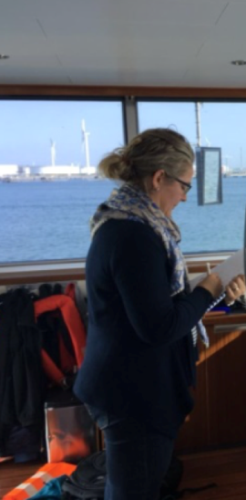
Methodology
Field study on board to get a picture of the actual
Time occupancy and
Workload
Parallel activities
Urgency
by competences
Evaluation of the interviews and finding correlations

Slide 10
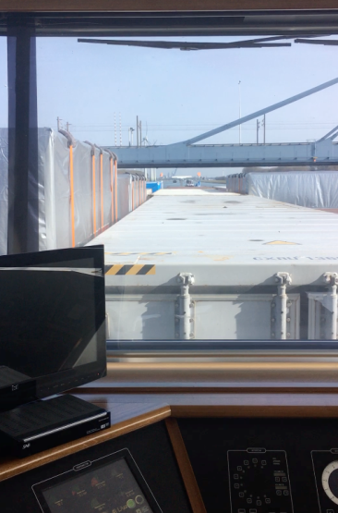
Methodology
Tasks structure:
Navigation
Operation of the craft
Cargo handling
Periodic inspection of marine engineering equipment
Maintenance & repair
Communication
HSE/ emergencies
Entrepreneuring
Other tasks
Recovery/ pause
Travel time

Slide 11
Parameters of the Research
Ship/Cargo type
Ship size
Operation mode
Sailing area
State of technical equipment

Slide 12
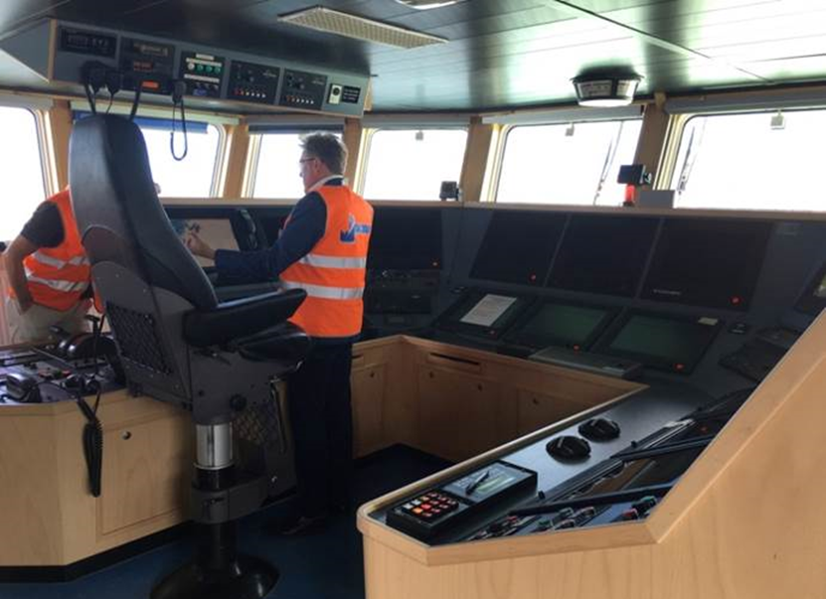
Vessel visits
Large hospitality
Service oriented taxi services
Shared meals
Trustful information shared

Slide 13
Organization of visits – our impression
Candidates sometimes not aware, not informed, though very helpful
Some companies not willing to participate
Need to feel free to speak, rarely difficult
High flexibility research partner needed in planning; very helpful organisations
Getting aboard on operational facility sometimes limited by 3rd parties (harbour/ company)
Language proficiency sometimes limiting

Slide 14
Vessel visits
Navigational conditions during visits
Daylight (clear visibility)
Regular up to high water level
No critical situations

Slide 15
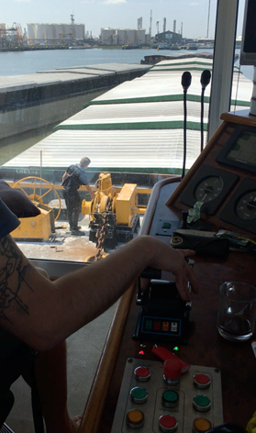
Vessel Visits – 1. Dry bulk
5 Vessels (+ 2 planned)
Length: 55 … 110 m
Width: 6.6 … 10.5 m
Operation areas: Rhine, Main, Canals (D/B/NL), Weser, Hunte
Operation modes: A1, A2, B

Slide 16
Vessel Visits – 2. Liquid bulk
5 Vessels (+ 2 planned)
Length: 86 … 125 m
Width: 9.5 … 22.8 m
Operation areas: Rhine, Main, Danube, Elbe, Canals (D/NL), ARA
Operation modes: A1, A2, B

Slide 17
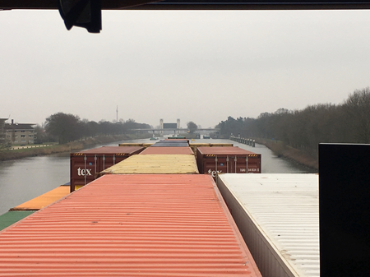
Vessel Visits – 3. Container
7 Vessels
Length: 85 … 180 m
Width: 9.33 … 17.1 m
Operation areas: Rhine, France, ARA, Zeebrugge
Operation modes: A1, A2, B

Slide 18
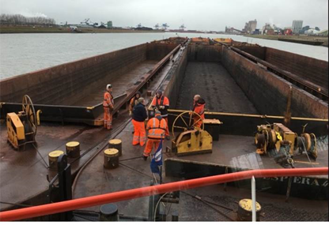
Vessel Visits – 4. Convoys
7 Vessels
Length: 17 … 269.5 m
Width: 9 … 22.8 m
Operation areas: Rhine, Main, Danube, Weser, ARA, Canals(D)
Operation modes: A1, A2, B

Slide 19
Vessel Visits – 5. Day Trip / Ferries
5 Vessels (+ 1 planned)
Length: 37.2 … 50 m
Width: 4.6 … 20 m
Operation areas: Rhine, Saar, Rhone, Neckar
Operation modes: A1, A2

Slide 20
Vessel Visits – 6. Cabin
4 Vessels (+ 2 planned)
Length: 114 … 135 m
Width: 11.4 m
Operation areas: Rhine, Main, Danube, Moselle, Maas, Frisian Lakes, Rhone, Seine,
Operation modes: B

Slide 21
Vessel Visits – 7. Tugs
3 Vessels (+ 1 planned)
Length: 15 m
Width: 4.3 m
Operation areas: Rhine, ARA

Slide 22
Overview visited vessels
Type Area | Dry bulk vessels | Liquid bulk vessels | Con-tainer vessels | Pushed/ coupl. convoys | Daytrip vessels & ferries | Cabin vessels | Tugs | TOTAL
Rhine & tributaries, incl. canals, incl. France incl. Weser etc. | 6 + 2 | 4 + 2 | 3 (+4) (France, below) | 5 (+2) (Dan., below) | 4 + 1 | 2 + 2 (+1) (Dan. below) | 3(+1?) | 27 +8 (+7 bel.)
Danube |  | 1 |  | 2 |  | 1 |  | 4
France (besides Rhine) |  |  | 4 |  | 1 | 1 |  | 6
TOTAL | 6 + 2 | 5 + 2 | 7 | 7 | 5 + 1 | 4 + 2 | 3(+1?) | 37(+8) (=45)

Slide 23
Vessel visits / Challenges
Challenges met with organisation and execution of ship visits
8 vessels planned
5 vessels presently missing
mainly 3-4 tugs
Shall be dealt with on short notice
Support needed (contacts)
Option: substitute tugs by other types
Results will be maintained/ incorporated

Slide 24
Preliminary general conclusions I
No ship says more crew on board needed than regulatory required
Some vessels indicate to sail sometimes (on purpose) with less crew than required by regulations and that work processes or safety seem not really affected
Most vessels know strict hierarchy in task allocation and working times (some do intensive cooperation, flexible working times and task allocation)

Slide 25
Preliminary general conclusions II
Workload limited/ acceptable
Sometimes higher cognitive workload:
short duration, low occurrence, low predictability long term
long duration (e.g. radar navigation during fog / at night etc.)
Physical workload: mostly static, low intensity, sometimes small peaks

Slide 26
Preliminary general conclusions III
Future technical developments can influence workload or time for several tasks (➔ workshops)
Influence of variable route, traffic and vessel characteristics
Working hours dominant in workload & recovery
24/7: short sleeps (average 4, max 5 hours, if 6h shift)
time of day

Slide 27
Preliminary general conclusions IV
Certain (rare) tasks are easier to handle with additional hands e.g.
handling hoses during (un-)loading tanker
(un-)mooring XXL volume vessels,
handling dangerous goods (intermittent tank cleaning) etc.
(Additional) personnel non necessarily on board

Slide 28
Preliminary approach
Categorizing tasks
Must be done on board, directly contributing to goal of transporting cargo/ passengers
usually done on board, supporting the primary processes & tasks, but could be outsourced / automated
other (more generic) tasks that occur during work, not time-bound

Slide 29
1. Navigation (Cat I)
Time occupancy (0.5 … 100% of shift for Boatmaster)
during sailing / manoeuvring usually uninterrupted time occupancy
Absolute navigation times vary (vessel, trip etc)
Employees: following shift rhythm
Ship owner: as long as it is allowed by reg. (tendency)
Preparation of journey depending on believed familiarity; mostly implicit & ad hoc via friends
Time occupancy boatman dictated by logistic planning and resulting journey planning; sometimes disturbing recovery
In parallel possible: remote inspection, communication, entrepreneuring, when work load is undemanding; keeps people busy

Slide 30
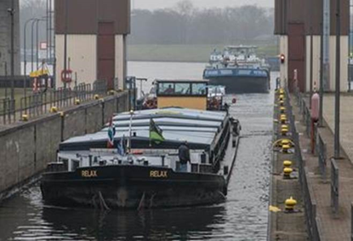
1. Navigation (Cat I)
Work load:
Moderately (seldom extremly), undemanding
demanding peaks due to traffic/obstacles
Peaks rarely coped with by alternation / extra recovery
reduced sight increases demand
Qualification: patent (boatmaster, helmsman)

Slide 31
2. Cargo handling (Cat. I/II)
Time occupancy (1.25 … 25% for Boatmaster, 0.75 … 75% for Boatman)
During (un-)loading
Absolute time varies (dep. on cargo/passengers, ship size, local sit.)
During the voyage/ while cargo is on board
dangerous goods: moderate/high
Other cargo: practically no
Division of work between boatmaster and boatman and care for cargo handled differently
In parallel possible: inspection, communication, entrepreneuring

Slide 32
2. Cargo handling
Work load (Boatmaster / Boatman)
Mentally undemanding except for dangerous goods
Boatmaster is responsible for stability and structural load
Physically demanding for e.g.
barge coupling
Hatches
Tank cleaning
Handling hoses for liquid cargo

Slide 33
3. Operation of the craft
Time occupancy (0.5 … 38.5% for Boatmaster, 0.38 … 12.5% for Boatman)
Ballast water (Cat. I)
Bunkering (Cat. II)
Time occupancy varies (dep. on ship type, size etc.) in general: rather short

Slide 34
3. Operation of the craft
Work load
Mentally moderately / extremely undemanding
Can be physically demanding (e.g. heavy hoses for bunkering)

Slide 35
4. Periodic inspections (Cat. II)
Time occupancy varies strongly (2 … 25%)
Mostly done by the boatman
Time occupancy in general correlates to the age of the equipment and the “requirements” of the cargo
In principle can be completely outsourced to service partner (→ predictive maintenance; in development esp. by shipping companies)
Depending from low/ high precision standard of boatmaster

Slide 36
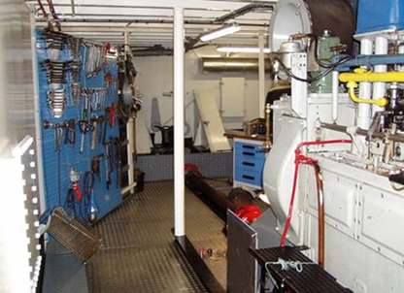
4. Periodic inspections (Cat. II)
Work load: moderately undemanding

Slide 37
5. Maintenance & Repair
Maintenance (Cat. II)
Repair (Cat. I/II)
Time occupancy (0.5 … 38% for Boatmaster, 8 … 69% for Boatman)
In general correlates to the age of equipment part
Sometimes outsourced to service partner (internal or external)
Painting is sometimes done, because boatmen are available
but also depends on demand / standard / preciseness of boatmaster
Depending from type of cargo (sensitive to dirt)
Seasonal influences: spring on deck; winter inside

Slide 38
5. Maintenance & Repair
Workload
Mostly moderately undemanding
Peaks to moderately / extremely demanding

Slide 39
6. Communication (Cat. I)
Internal
Boatmaster
Short time occupancy, often combined with coffee break
External
During navigation (as part of navigation)
limited extent entrepreneuring (owners)

Slide 40
6. Communication (Cat. I)
Workload
In general moderately undemanding (but depending on experience of crew)
However, in case of foreign languages & crews sometimes quite demanding (e.g. cabin vessels in France with foreign boatmaster)
Perception / Approach
More communication at critical situations considered reasonable
Standardized communication ‘tools’, phrases etc. on European level considered reasonable

Slide 41
7. HSE / Emergencies (Cat I)
Time occupancy is rather low (1-2 d/y)
Often regular training scheduled
mostly for employees/shipping companies
In case of emergency
Full time occupancy
High demanding
But very seldom

Slide 42
8. Entrepreneuring (Cat. II)
Not relevant for employees (onboard)
Owner operators: Handled on various ways, e.g.
long term freight contracts
use of service partners, transport market place
Member of a cooperative
‘outsourced’ to family partner (not counted as crew member)
Self- done: variable number of hours

Slide 43
9. Other Tasks
Time occupancy
Cooking: up to 3.5h (on / off shift)
Personal hygiene: appr. 1h (off shift)
Meals: 1h (off shift)
Studying: only unexperienced crew
Waiting is daily business for boatmen, mostly replaced by some maintenance, additional breaks / ‚hanging around‘
Boatmasters: Waiting times replaced by additional breaks or maintenance

Slide 44
10. Recovery / Pause
Shift system
2 × 6h allows not enough sleep (mostly mode B)
1½ × 8h leads to alternating day/night shifts (mostly mode A1/A2)
On/off-board time
long rhythms (e.g. 14/14 or 28/28 days) can lead to family problems
Quality of rest varies
Noisy bridge lowering installations,
suboptimal routing/ location cabins, etc.

Slide 45
10. Recovery
Ship Owners (owner operators)
Less holidays
Younger ship owners are willing to work as much as allowed
elder ship owners tend to more recreation time, e.g. free weekend

Slide 46
11. Travel
Handled quite different
Can be counted as working or private time
Some companies require for long travels a night in hotel before boarding,
Long journeys, e.g. Latvia - Germany

Slide 47
Preliminary Conclusions
Time occupancy
Pure navigation: 1 person needed
Navigation time is limited by fatigue
Operation time = max. navigation time * number of persons
Additional personal (1 or more) is needed for specific tasks on specific occasions
Summing these up, might lead to full day occupancy
Outsourcing/technical systems might reduce additional occupancy to zero ➔ Workshop

Slide 48
Preliminary Conclusions
Work load
Observation: mostly moderately or extremely undemanding
Certain tasks are moderately / extremely demanding
However, technical solutions / assistance available

Slide 49
State of technical equipment
Mixed picture
By far not all options used at present
Vessel age is no indicator for (technical) equipment
Various modernisations during vessel life time
Modernisation is also a question of rentability & financing (and market situation / conditions)

Slide 50
Legislative Framework (selection)
COUNCIL DIRECTIVE 2014/112/EU of 19 December 2014 implementing the European Agreement concerning certain aspects of the organisation of working time in inland waterway transport, concluded by the European Barge Union (EBU), the European Skippers Organisation (ESO) and the European Transport Workers' Federation (ETF)
Verordnung über das Schiffspersonal auf dem Rhein (RheinSchPersV), ZKR/CCNR
Verordnung über die Arbeitszeit in der Binnenschifffahrt (Binnenschifffahrts-Arbeitszeitverordnung - BinSchArbZV)
BinSchUO 2008, Anh. XI
Verordnung des Bundesministers für Verkehr, Innovation und Technologie über die Mindestbesatzung von Fahrzeugen (Schiffsbesatzungsverordnung), StF: BGBl. II Nr. 518/2004
Danube (Austria): Schiffsbesatzungsverordnung – 518. Verordnung des Bundesministers für Verkehr, Innovation und Technologie über die Mindestbesatzung von Fahrzeugen

Slide 51
Outlook to future regulation
Manning is based on time occupancy in combination with workload for tasks on board
Depending on technical equipment and/or outsourcing
Working time differs between employees and owner operators

Slide 52
Qualification
Ship owners have problems to find qualified personnel (Companies have not been asked).
Labour market for additional personnel is limited.
Languages are a notable problem (compare Slide on Communication/Workload above)

Slide 53
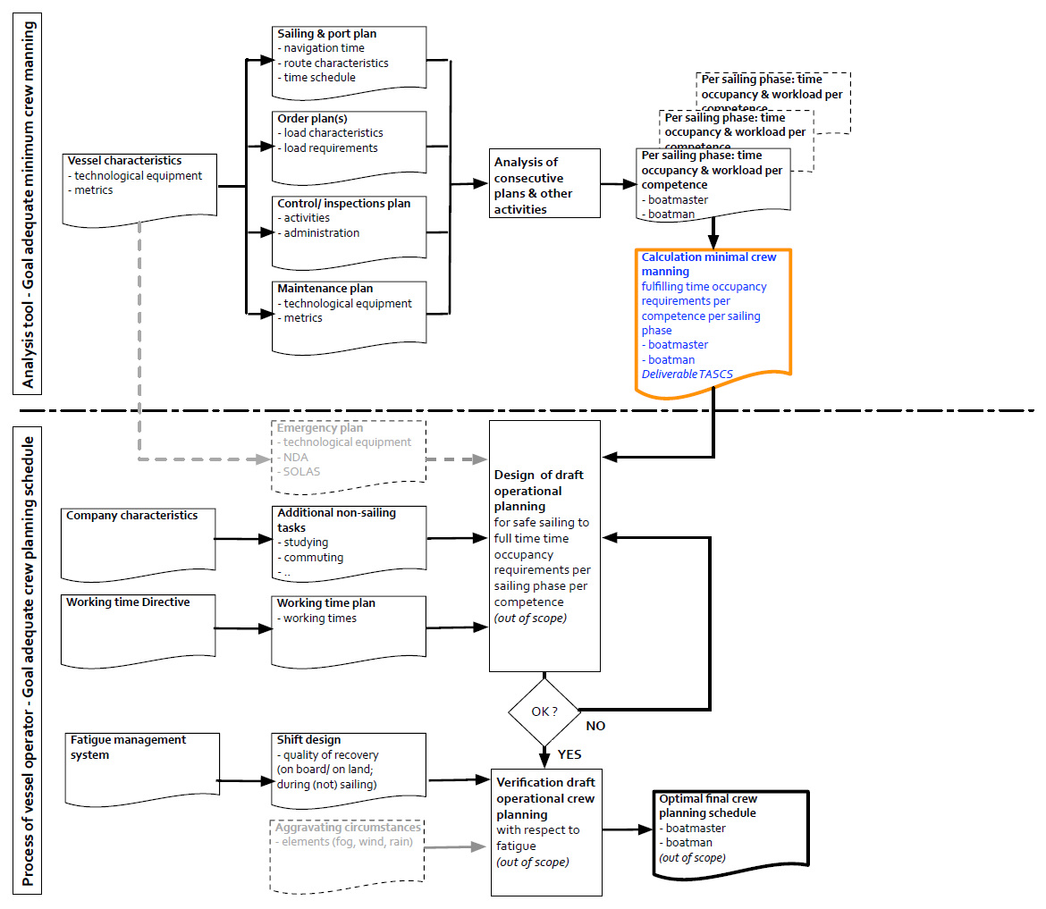
first impression possible draft future tool

Slide 54
Agenda
10.30 Introduction to TASCS project (PS)
11.00 Tour de table of all present
11.15 Introduction on practicalities project
11.30 Presentation research
12.30 Lunch
14.00 Presentation research (continued)
15.00 Coffee break
15.30 Discussion
16.30 Summary
17.00 Any other business

Slide 55
Next step: Expert workshop June
Goal: look into future
Non-technical developments
Outsourcing to service partners
Transport demands
Logistic requirements
Crew planning requirements
Legal framework & legislation / enforcement
Labour market

Slide 56
Next step: Expert workshop June
Goal: look into future
Technical aspects
Improved and additional equipment
Predictive maintenance
Assistance systems / (semi-)Autonomous navigation
Waterway & port infrastructures
Financing of technical improvement in correlation to savings of personnel

Slide 57
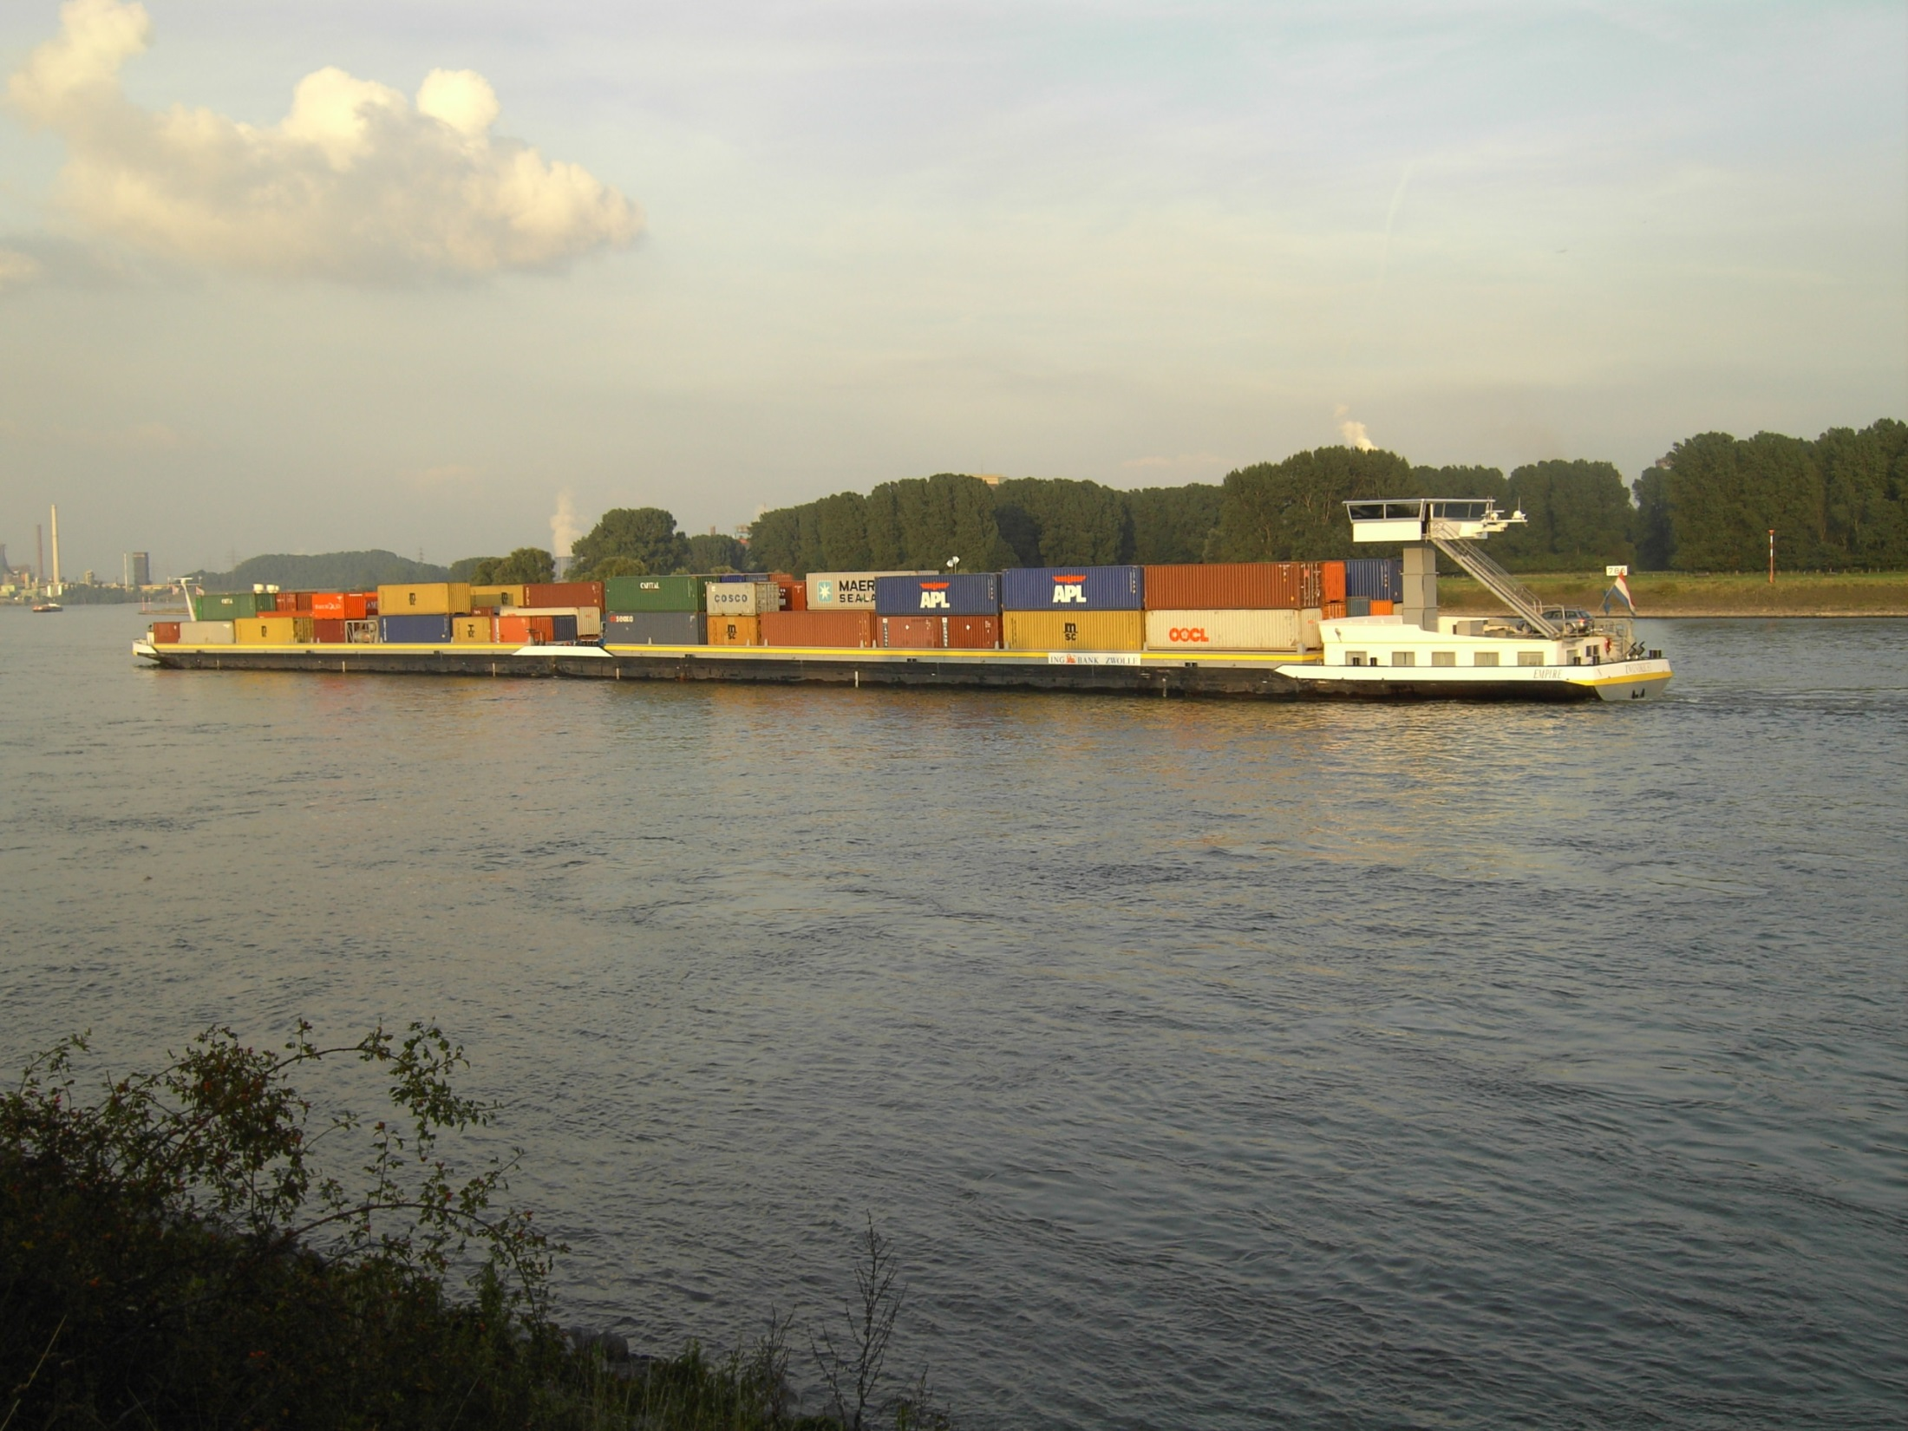
first impression possible draft future tool
Thank you very much for your attention!
© Picture: DST

